Slide 1
REVIEW PART I - HTML
Ranken Technical College

Slide 2
OBJECTIVES
Review HTML Document Structure
Explain Usage Of <!DOCTYPE html> Tag
Go Over Basic <head> Section Tags
Go Over Basic <body> Section Tags
Introduction To HTML <form>

Slide 3
HTML Document Structure
<!doctype html>
<html>
<head>
<meta>
<title>
<link>
</head>
<body>
<!-- Content -->
<src>
</body>
</html>

Slide 4
<!DOCTYPE html> Tag
<!DOCTYPE html> or <!doctype html> etc.
The required <!DOCTYPE html> preamble is found at the top of HTML documents. Its sole purpose is to prevent a browser from switching into so-called "quirks mode" when rendering a document

Slide 5
<html> Tag
<html lang="en">…</html>
The <html> tag is the container for all other HTML elements (except for the <!DOCTYPE> tag). You should always include the lang attribute inside the <html> tag, to declare the language of the Web page. This is meant to assist search engines and browsers. The lang attribute is recommended for validation

Slide 6
<head> Tag
<head>…</head>
The HTML <head> element contains machine-readable information (a.k.a. metadata) about the document, like its title, scripts, and style sheets

Slide 7
<meta> Tags
<meta>
The HTML <meta> tag defines metadata (data about data). <meta> tags are typically used to specify character set, page description, keywords, document author and viewport settings. Metadata is used by browsers (to display content or reload page), search engines (keywords), and other web services
e.g.: <meta charset="UTF-8">

Slide 8
<title> Tag
<title>
The HTML <title> element defines the document's title that is shown in a browser's title bar or a page's tab. It only contains text. Tags within the element are ignored
e.g.: <title>Home Page</title>

Slide 9
<link> Tag
<link>
The HTML External Resource Link element (<link>) specifies relationships between the current document and an external resource. <link> is most commonly used to link to stylesheets, but is also used with site icons (e.g. "favicon")
e.g.: <link rel="stylesheet" href="style.css">

Slide 10
HTML5 Semantic Tags
Major HTML 5 Semantic Tags:
<article>
<aside>
<figure>
<footer>
<header>
<main>
<nav>
<section>

Slide 11
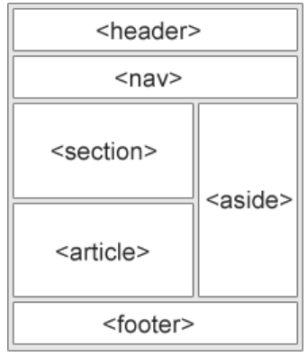
HTML5 Semantic Tags
HTML 5 Semantic Tags:

Slide 12
<div>
<div>…</div>
The HTML Content Division element <div> is the generic container for flow content. It has no effect on the content or layout until styled using CSS

Slide 13
<span>
<span>…</span>
The HTML <span> element is a generic inline container for phrasing content which does not inherently represent anything. It can be used to group elements for styling purposes or because they share attribute values. <span> is much like a <div> element, but <div> is a block-level element whereas a <span> is an inline element

Slide 14
Block-Level Elements
Block-level elements
A block-level element occupies the entire space of its parent element (container), thereby creating a "block". Browsers typically display the block-level element with a newline both before and after the element
e.g.: <form>, <hr>, <li>, <ol>, <p>, <table>, <ul>

Slide 15
Inline Elements
Inline elements
Inline elements are those which only occupy the space bounded by the tags defining the element, instead of breaking the flow of the content. An inline element does not start on a new line and only takes up as much width as necessary
e.g.: <a>, <b>, <br>, <em>, <i>, <img>

Slide 16
<ol> Tag
Ordered List <ol>…</ol>
The HTML <ol> element represents an ordered list of items – typically rendered as a numbered list
<ol> Renders as:
<li>Element 1</li> 1. Element 1
<li>Element 2</li> 2. Element 2
</ol>

Slide 17
<ul> Tag
Unordered List <ul>…</ul>
The HTML <ul> element represents an unordered list of items – typically rendered as a bulleted list
<ul> Renders as:
<li>An Element </li> • An element
<li>Another Element</li> • Another element
</ul>

Slide 18
HTML Forms
.
<form action=“val.js" method="POST/GET">…</form>
The HTML <form> element represents a document section containing interactive controls for submitting information
The action attribute is the URL that processes the form submission. The method attribute is used to submit the form via POST (method body) or GET (query string)

Slide 19
HTML Form Tags
.
Major form tags:
input - Creates interactive form controls to accept user data
select - Creates a control that provides a menu of options
textarea - Creates a multi-line plain-text editing control
button - Creates a clickable (programmable) button
fieldset - Groups controls and labels within a web form
legend - Creates a caption for a corresponding fieldset

Slide 20
HTML Form Example
.
<form action="validate.js" method="POST">
<fieldset legend="Simple Form">
<input type="email" id="email" placeholder="Email Here"><br><br>
<select id="favpet">
<option value="">--Favorite pet--</option>
<option value="dog">Dog</option>
<option value="cat">Cat</option>
<option value="bird">Bird</option>
</select><br><br>
<button>Submit</button>
</fieldset>
</form>

Slide 21
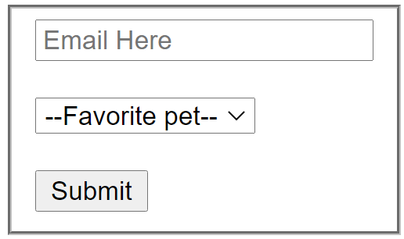
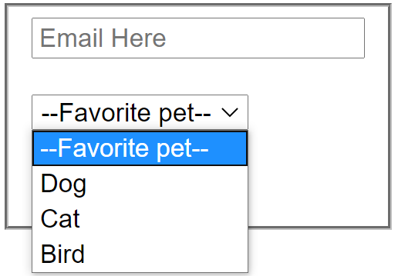
HTML Form Example
.
Added CSS:
<style>
fieldset {
display: inline-block;
}
</style>

Slide 22
WHAT WE COVERED
HTML Document Structure
<!DOCTYPE html> Tag
<head> Section Tags
<body> Section Tags
HTML <form> Tag

Slide 23
USEFUL HTML LINKS
https://developer.mozilla.org/en-US/docs/Web/JavaScript
https://developer.mozilla.org/en-US/docs/Learn/Getting_started_with_the_web
https://www.w3schools.com/Html/

